Slide 1

Chapter 11 :: Logic Languages
Programming Language Pragmatics
Michael L. Scott
Copyright © 2009 Elsevier

Slide 2
Logic Programming
Based on predicate calculus
Predicates - building-blocks P(a₁,a₂,...,a_{K})
  limit(f, infinity, 0)
  enrolled(you, CS xxx)
  These are interesting because we attach meaning to them, but within the logical system they are simply structural building blocks, with no meaning beyond that provided by explicitly-stated interrelationships
Copyright © 2009 Elsevier

Slide 3
Logic Programming Concepts
Operators
  conjunction, disjunction, negation, implication
Universal and existential quantifiers
Statements
  sometimes true, sometimes false, often unknown
  axioms - assumed true
  theorems - provably true
  hypotheses (goals) - things we'd like to prove true
Copyright © 2009 Elsevier

Slide 4
Logic Programming Concepts
Example statements:
all f, l [
limit(f, x0, l) <=>
(all e [
e > 0 => (exists d [
d > 0 and all x [
((|x-x0| < d) => (|f(x)-l|) < e)]])])]
all f, g [f = O(g) <=
(exist c, n0 [
all n [
n > n0 => f(n) < cg(n)]])]
Copyright © 2009 Elsevier

Slide 5
Logic Programming Concepts
Most statements can be written many ways
That's great for people but a nuisance for computers
  It turns out that if you make certain restrictions on the format of statements you can prove theorems mechanically
  That's what logic programming systems do
  Unfortunately, the restrictions that we will put on our statements will not allow us to handle most of the theorems you learned in math, but we will
  have a surprising amount of power left anyway
Copyright © 2009 Elsevier

Slide 6
Logic Programming Concepts
We insist that all statements be in the form of HORN CLAUSES consisting of
a HEAD and a BODY
  The head is a single term
  The body is a list of terms
  A term can be a constant, variable, or STRUCTURE consisting of a FUNCTOR and a parenthesized list of arguments
Copyright © 2009 Elsevier

Slide 7
Logic Programming Concepts
A structure can play the role of a data structure or a predicate
  A constant is either an ATOM or a NUMBER
  An atom is either what looks like an identifier beginning with a lower-case letter, or a quoted character string
  A number looks like an integer or real from some more ordinary language
  A variable looks like an identifier beginning with an upper-case letter
  There are no declarations
  All types are discovered implicitly
Copyright © 2009 Elsevier

Slide 8
Logic Programming Concepts
The meaning of the statement is that the conjunction of the terms in the body implies the head
  A clause with an empty body is called a FACT
  A clause with an empty head is a QUERY, or top-level GOAL
  A clause with both sides is a RULE
The Prolog interpreter has a collection of facts and rules in its DATABASE
  Facts are axioms - things the interpreter assumes to be true
Copyright © 2009 Elsevier

Slide 9
Prolog
Prolog can be thought of declaratively or imperatively:
  We’ll emphasize the declarative semantics for now, because that's what makes logic programming interesting
  We'll get into the imperative semantics later
Prolog allows you to state a bunch of axioms
  Then you pose a query (goal) and the system tries to find a series of inference steps (and assignments of values to variables) that allow it to prove your
  query starting from the axioms
Copyright © 2009 Elsevier

Slide 10
Prolog
The meaning of the statement is that
mother(mary, fred).
% you can either think of this as % an predicate asserting that mary
% is the mother of fred -
% or a data structure (tree)
% in which the functor (atom)
% mother is the root,
% mary is the left child, and
% fred is the right child
fat(albert).
rainy(rochester).
Copyright © 2009 Elsevier

Slide 11
Prolog
Rules are theorems that allow the interpreter to infer things
To be interesting, rules generally contain variables
employed(X) :- employs(Y,X).
can be read:
for all X, X is employed if there
exists a Y such that Y employs X
Note the direction of the implication:
  The example does NOT say that X is employed ONLY IF there is a Y that employs X
Copyright © 2009 Elsevier

Slide 12
Prolog
The scope of a variable is the clause in which it appears
  Variables whose first appearance is on the left hand side of the clause have implicit
  universal quantifiers
  Variables whose first appearance is in the body of the clause have implicit existential quantifiers
Similarly:
Copyright © 2009 Elsevier

Slide 13
Prolog
grandmother(A, C) :- mother(A, B), mother(B, C).
can be read:
for all A, C [A is the grandmother of C if there exists a B such that A is the mother of B and B is the mother of C].
We probably want another rule that says
grandmother(A, C) :- mother(A, B), father(B, C).
Copyright © 2009 Elsevier

Slide 14
Prolog
To run a Prolog program, one asks the interpreter a question
  This is done by stating a theorem - asserting a predicate - which the interpreter tries to prove
    If it can, it says yes
    If it can't, it says no
    If your predicate contained variables, the interpreter prints the values it had to give them to make the predicate true.
Copyright © 2009 Elsevier

Slide 15
Prolog
The interpreter works by what is called BACKWARD CHAINING
  It begins with the thing it is trying to prove and works backwards looking for things that
  would imply it, until it gets to facts
It is also possible in theory to work forward from the facts trying to see if any of the things you can prove from them are what you were looking for - that can be very time-consuming
  Fancier logic languages use both kinds of chaining, with special smarts or hints from the user to bound the searches
Copyright © 2009 Elsevier

Slide 16
Prolog
The predicate you ask for is the interpreter's original GOAL
  In an attempt to SATISFY that goal, it looks for facts or rules with which the goal can be UNIFIED
    Unification is a process by which compatible
    statements are merged
  Any variables that do not yet have values but
  which correspond to constants or to variables with values in the other clause get INSTANTIATED with that value
  Anyplace where uninstantiated variables correspond, those variables are identified with each other, but remain without values
Copyright © 2009 Elsevier

Slide 17
Prolog
The interpreter starts at the beginning of your database (this ordering is part of Prolog, NOT of logic programming in general) and looks for something with which to unify the current goal
  If it finds a fact, great; it succeeds
  If it finds a rule, it attempts to satisfy the terms in the body of the rule depth first
  This process is motivated by the RESOLUTION PRINCIPLE, due to Robinson:
    It says that if C1 and C2 are Horn clauses, where C2 represents a true statement and the head of C2 unifies with one of the terms in the body of C1, then we can replace the term in C1 with the body of C2 to obtain another statement that is true if and only if C1 is true
Copyright © 2009 Elsevier

Slide 18
Prolog
When it attempts resolution, the Prolog interpreter pushes the current goal onto a stack, makes the first term in the body the current goal, and goes back to the beginning of the database and starts looking again
If it gets through the first goal of a body successfully, the interpreter continues
with the next one
If it gets all the way through the body, the goal is satisfied and it backs up a level and proceeds
Copyright © 2009 Elsevier

Slide 19
Prolog
If it fails to satisfy the terms in the body of a rule, the interpreter undoes the unification of the left hand side (this includes uninstantiating any variables that were given values as a result of the unification) and keeps looking through the database for something else with which to unify (This process is called BACKTRACKING)
If the interpreter gets to the end of database without succeeding, it backs out a level (that's how it might fail to satisfy something in a body) and continues from there
Copyright © 2009 Elsevier

Slide 20
Prolog
We can visualize backtracking search as a tree in which the top-level goal is the root and the leaves are facts (see Figure 11.2 - next slide)
  The children of the root are all the rules and facts with which the goal can unify
  The interpreter does an OR across them: one of them must succeed in order for goal to succeed
  The children of a node in the second level of the tree are the terms in the body of the rule
  The interpreter does an AND across these: all of them must succeed in order for parent to succeed
  The overall search tree then consists of alternating AND and OR levels
Copyright © 2009 Elsevier

Slide 21
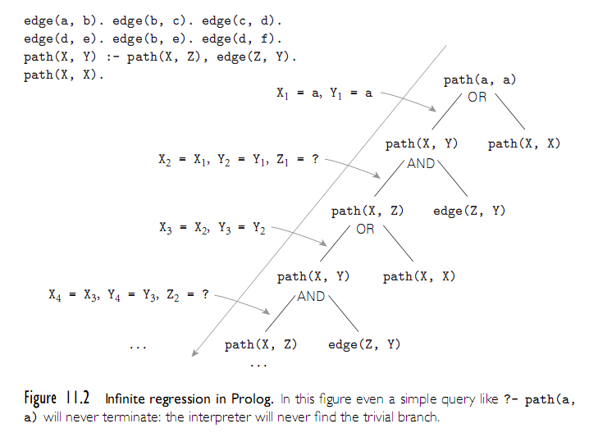
Prolog
Copyright © 2009 Elsevier

Slide 22
Prolog
PROLOG IS NOT PURELY DECLARATIVE
  The ordering of the database and the left-to-right pursuit of sub-goals gives a deterministic imperative semantics to searching and backtracking
  Changing the order of statements in the database can give you different results
    It can lead to infinite loops
    It can certainly result in inefficiency
Tree relationships:
Copyright © 2009 Elsevier

Slide 23
Prolog
parent(a,b). % a is the parent of b
parent(a,d).
parent(a,k).
parent(k,l).
parent(k,m).
parent(b,e).
parent(b,f).
parent(f,g).
parent(f,h).
parent(f,i).
ancestor(X,Y) :- parent(X,Y).
ancestor(X,Y) :- parent(Z,Y), ancestor(X,Z).
Copyright © 2009 Elsevier

Slide 24
Prolog
Then the question
?- ancestor(U,h).
generates the answers
U = f;
U = b;
U = a;
no
The question
?- ancestor(b,U).
generates all nodes in the subtree rooted in b << trace >>
Copyright © 2009 Elsevier

Slide 25
Prolog
If we change the order of the two ancestor rules, we get different execution orders:
?- ancestor(U,h).
U = a;
U = b;
U = f;
no
If we change the order of the subgoals in the compound rule,
ancestor(X,Y) :- ancestor(X,Z), parent(Z,Y).
we run into an infinite loop (see also Figure 11.2)
Copyright © 2009 Elsevier

Slide 26
Prolog
Arithmetic: The '=' operator determines whether its operands can be unified
?- A = 37.
A = 37
yes
?- 2 = 2.
yes
Math operators are functors (structure names), not functions
?- (2+3) = 5
no
Copyright © 2009 Elsevier

Slide 27
Prolog
For math we use the built-in operator is
?- is(X, 1+2).
X = 3
yes
?- X is 1+2.
X = 3
yes
% LHS of 'is' must be as-yet uninstantiated
?- 1+2 is 4-1.
no
% RHS of 'is' must already be instantiated
?- X is Y.
<error>
Copyright © 2009 Elsevier

Slide 28
Prolog
Tic-tac-toe (see Figure 11.3 on next slide)
  This program finds the next move, given
  a board configuration
  It does not play a whole game (see the book for an extended version that does)
  It depends on the ordering of rules
    move(A) is the root rule
    A is a result parameter
  No winning strategy
    each player can force a draw
Copyright © 2009 Elsevier

Slide 29
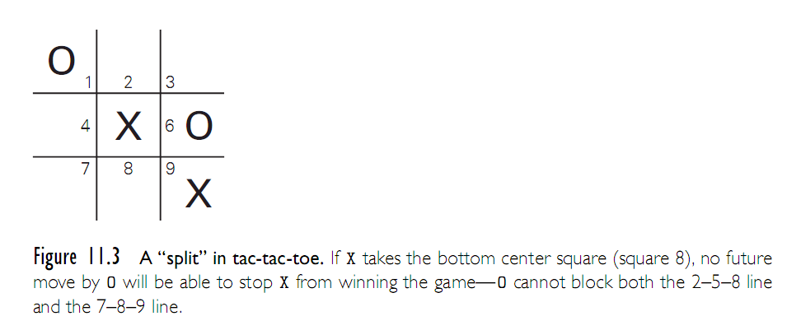
Prolog
Copyright © 2009 Elsevier

Slide 30
Logic Programming Examples
% express that three given squares lie in a line
ordered_line(1,2,3). ordered_line(4,5,6).
ordered_line(7,8,9). ordered_line(1,4,7).
ordered_line(2,5,8). ordered_line(3,6,9).
ordered_line(1,5,9). ordered_line(3,5,7).
line(A,B,C) :- ordered_line(A,B,C).
line(A,B,C) :- ordered_line(A,C,B).
line(A,B,C) :- ordered_line(B,A,C).
line(A,B,C) :- ordered_line(B,C,A).
line(A,B,C) :- ordered_line(C,A,B).
line(A,B,C) :- ordered_line(C,B,A)
% we assume a not so perfect opponent
Copyright © 2009 Elsevier

Slide 31
Prolog
% the following rules work well
move(A) :- good(A), empty(A).
full(A) :- x(A).
full(A) :- o(A).
empty(A):- not full(A)
% strategy (key is ordering following five rules)
good(A) :- win(A).
good(A) :- block_win(A).
good(A) :- split(A).
good(A) :- block_split(A).
good(A) :- build(A).
Copyright © 2009 Elsevier

Slide 32
Prolog
% first choice is to win(1)
win(A) :- x(B), x(C), line(A,B,C).
% block opponent from winning (2)
block_win(A) :- o(B), o(C), line(A,B,C).
% opponent cannot block us from winning next
% see Figure 11.6 before for this case(3)
split(A) :- x(B), x(C), different(B,C),
line(A,B,D), line(A,C,E),
empty(D), empty(E).
same(A,A).
different(A,B) :- not same(A,B).
Copyright © 2009 Elsevier

Slide 33
Prolog
% prevent opponent from creating a split (4)
block_split(A) :- o(B), o(C), different(B,C),
line(A,B,D), line(A,C,E),
empty(D), empty(E).
% pick a square toward three in a row (5)
build(A) :- x(B), line(A,B,C), empty(C).
% if non of the five, final defaults (in this order)
good(5).
good(1). good(3). good(7). good(9).
good(2). good(4). good(6). good(8).
Copyright © 2009 Elsevier

